Slide 1
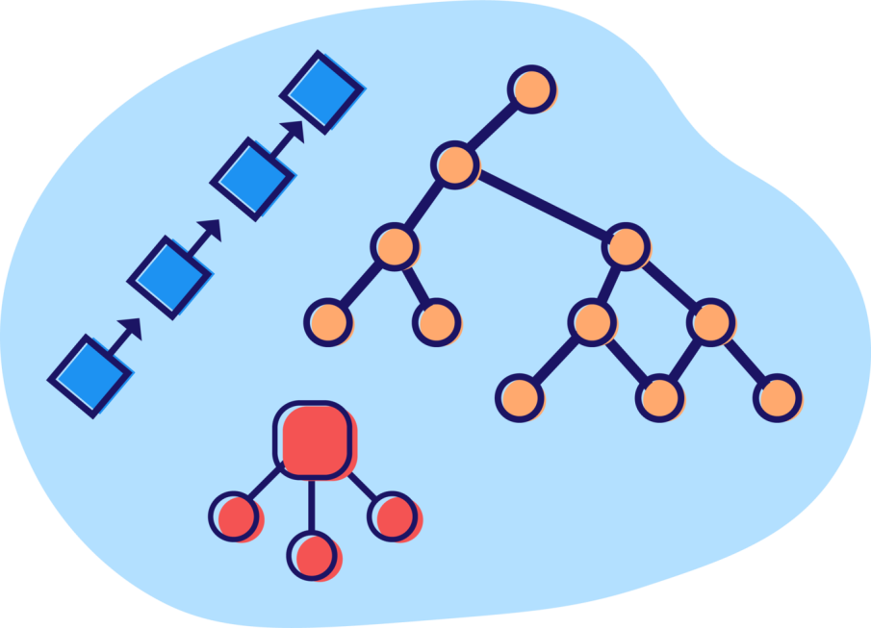
DSA – Data Structure and Algorithms
What is DS? A data structure is basically a group of data elements that are put together under one name, and which defines a particular way of storing and organizing data in a computer so that it can be used efficiently.

Slide 2
Introduction
A data structure is an arrangement of data either in computer's memory or on the disk storage.
Some common examples of data structures are arrays, linked lists, queues, stacks, binary trees, graphs, and hash tables.
Data structures are widely applied in areas like:
Compiler design
Operating system
Statistical analysis package
DBMS
Numerical analysis
Simulation
Artificial Intelligence

Slide 3
Introduction to data structures
BASIC TERMINOLOGY
Our aim has been to design good programs, where a good program is defined as a program that runs correctly
is easy to read and understand
is easy to debug and
is easy to modify.
A program should undoubtedly give correct results, but along with that it should also run efficiently.
A program is said to be efficient when it executes in minimum time and with minimum memory space.
In order to write efficient programs we need to apply certain data management concepts.
The concept of data management is a complex task that includes activities like data collection, organization of data into appropriate structures.
Data structure is a crucial part of data management.

Slide 4
Data structures are used in almost every program .
Some common examples of data structures
arrays, linked lists, queues, stacks, binary trees, and hash tables.
Data structures are widely applied in the following areas:
Compiler design , Operating system ,Statistical analysis package , DBMS
The primary goal of a program or software is not to perform calculations or operations but to store and retrieve information as fast as possible.
A solution is said to be efficient if it solves the problem within the required resource constraints like the total space available to store the data and the time allowed to perform each subtask. And the best solution is the one that requires fewer resources than known alternatives.
Moreover, the cost of a solution is the amount of resources it consumes. The cost of a solution is basically measured in terms of one key resource such as time, with the implied assumption that the solution meets the other resource constraints.

Slide 5
When selecting a data structure to solve a problem, the following steps must be performed.
Analysis of the problem to determine the basic operations that must be supported. For example, basic operation may include inserting/deleting/searching a data item from the data structure.
Quantify the resource constraints for each operation.
Select the data structure that best meets these requirements.
Note: While one type of data structure may permit adding of new data items only at the beginning, the other may allow it to be added at any position.
While one data structure may allow accessing data items sequentially, the other may allow random access of data. So, selection of an appropriate data structure for the problem is a crucial decision and may have a major impact on the performance of the program.

Slide 6
Elementary Data Structure Organization
DS –building block of a program
A program built using improper data structures may not work as expected.
So as a programmer it is mandatory to choose most appropriate data structures for a program.
DATA - a value or set of values.
It specifies either the value of a variable or a constant
(e.g., marks of students, name of an employee, address of a customer, value of pi, etc.).
Data item – No subordinate data items is categorized as an elementary item
Data item - one or more subordinate data items is called a group item.
EG, a student’s name may be divided into three sub-items—first name, middle name, and last name—but his roll number would normally be treated as a single item.

Slide 7
Record - collection of data items.
EG, the name, address, course, and marks obtained are individual data items. But all these data items can be grouped together to form a record.
FILE is a collection of related records.
EG, if there are 60 students in a class, then there are 60 records of the students.
All these related records are stored in a file.
A record in a file may consist of multiple data items but the value of a certain data item uniquely identifies the record in the file. Such a data item K is called a primary key, and the values K1 , K2 ... in such field are called keys or key values.
EG, in a student’s record that contains roll number, name, address, course, and marks obtained, the field roll number is a primary key. Rest of the fields (name, address, course, and marks) cannot serve as primary keys, since two or more students may have the same name, or may have the same address (as they might be staying at the same place), or may be enrolled in the same course, or have obtained same marks.

Slide 8
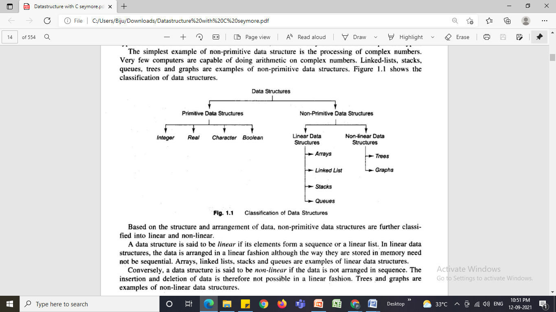
CLASSIFICATION OF DATA STRUCTURES

Slide 9
Classification of Data Structures
Primitive data structures are the fundamental data types which are supported by a programming language. Some basic data types are integer, real, and boolean. The terms ‘data type’, ‘basic data type’, and ‘primitive data type’ are often used interchangeably.
Non-primitive data structures are those data structures which are created using primitive data structures. Examples of such data structures include linked lists, stacks, trees, and graphs.
Non-primitive data structures can further be classified into two categories: linear and non-linear data structures.

Slide 10
Classification of Data Structures
If the elements of a data structure are stored in a linear or sequential order, then it is a linear data structure. Examples are arrays, linked lists, stacks, and queues.
If the elements of a data structure are not stored in a sequential order, then it is a non-linear data structure. Examples are trees and graphs.

Slide 11
Arrays
An array is a collection of similar data elements.
The elements of an array are stored in consecutive memory locations and are referenced by an index (also known as the subscript).
Arrays are declared using the following syntax:
type name[size];
1st element | 2nd element | 3rd element | 4th element | 5th element | 6th element | 7th element | 8th element | 9th element | 10th element
marks[0] marks[1] marks[2] marks[3] marks[4] marks[5] marks[6] marks[7] marks[8] marks[9]

Slide 12

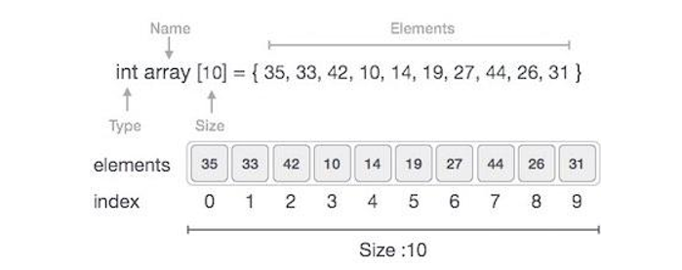
Array – Linear DS
Array is a container which can hold fix number of items and these items should be of same type. Most of the data structures make use of array to implement their algorithms. Following are important terms to understand the concepts of Array.

Slide 13
Linked Lists
A linked list is a very flexible dynamic data structure in which elements can be added to or deleted from anywhere.
In a linked list, each element (called a node) is allocated space as it is added to the list.
Every node in the list points to the next node in the list. Therefore, in a linked list every node contains two types of information:
The data stored in the node
A pointer or link to the next node in the list
1
2
3
4
5
6
7
X

Slide 14
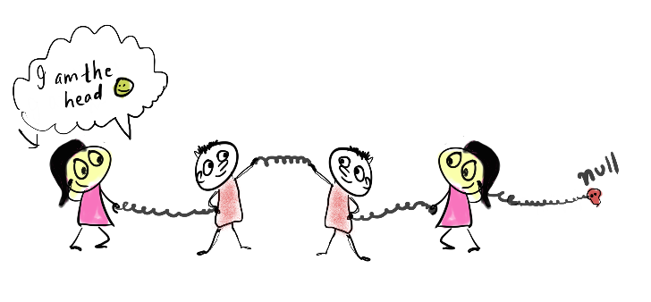
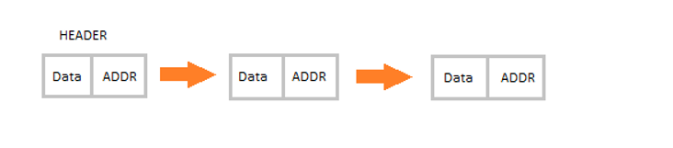
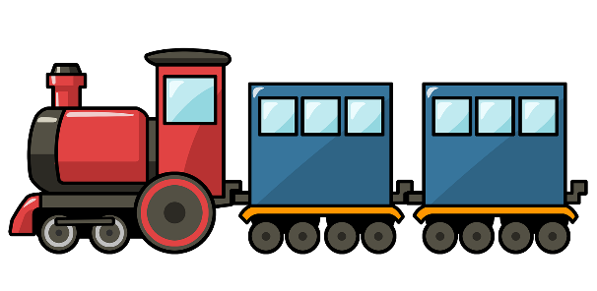
Linked List - Linear DS
Linked List is a linear data structure and it is very common data structure which consists of group of nodes in a sequence which is divided in two parts. Each node consists of its own data and the address of the next node and forms a chain.
A Flexible structure, because can grow and shrink on demand.
Elements can be:
Inserted
Accessed
Deleted
At any position

Slide 15
Singly linked list Example
head
1000
25
2000
55
2024
17
Null
Node 1
Node 2
Node 3
1000
2000
2024

Slide 16
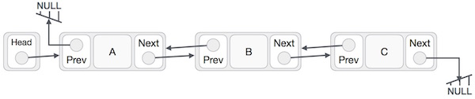
Doubly linked list Example

Slide 17
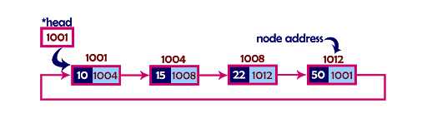
Circular linked list Example

Slide 18
Applications of linked list in real world-
Image viewer – Previous and next images are linked, hence can be accessed by next and previous button.
Previous and next page in web browser – We can access previous and next url searched in web browser by pressing back and next button since, they are linked as linked list.
Music Player – Songs in music player are linked to previous and next song. you can play songs either from starting or ending of the list.

Slide 19
Stack
A stack is a last-in, first-out (LIFO) data structure in which insertion and deletion of elements are done only at one end, known as TOP of the stack.
Every stack has a variable TOP associated with it, which is used to store the address of the topmost element of the stack.
If TOP = NULL, then it indicates that the stack is empty.
If TOP = MAX-1, then the stack is full.
A | AB | ABC | ABCD | ABCDE
0 1 2 3 TOP = 4 5 6 7 8 9

Slide 20
Push Operation
12
10
5

Slide 21
Pop Operation
12
10
5

Slide 22
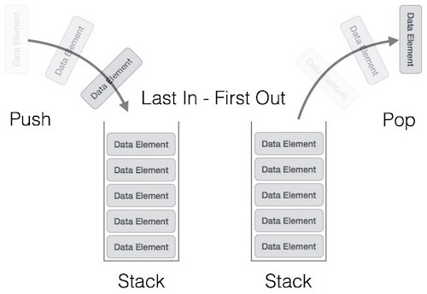
Stacks - Linear DS
Stack is an abstract data type with a bounded (predefined) capacity. It is a simple data structure that allows adding and removing elements in a particular order. Every time an element is added, it goes on the top of the stack, the only element that can be removed is the element that was at the top of the stack, just like a pile of objects.
Last in first out
insert/push
remove/pop
top

Slide 23
Applications of Stack
Expression Handling −Infix to Postfix or Infix to Prefix Conversion
Backtracking
Parenthesis Checking

Slide 24
Queue
A queue is a FIFO (first-in, first-out) data structure in which the element that is inserted first is the first one to be taken out.
The elements in a queue are added at one end called the REAR and removed from the other one end called FRONT.
When REAR = MAX – 1, then the queue is full.
If FRONT = NULL and Rear = NULL, this means there is no element in the queue.
 | 9 | 7 | 18 | 14 | 36 | 45
0 FRONT = 1 2 3 4 5 REAR = 6 7 8 9

Slide 25
Queues - Linear DS
Queue is also an abstract data type or a linear data structure, in which the first element is inserted from one end called REAR(also called tail), and the deletion of existing element takes place from the other end called as FRONT(also called head). This makes queue as FIFO data structure, which means that element inserted first will also be removed first.
Last in last out or first in first out
enqueue, dequeue, front
priority queues and dequeue
Front
Back
Data1
Data2
Data3
Data4

Slide 26
insertion Operation
12
10
5
Rear
Front

Slide 27
Deletion Operation
12
10
5
Rear
Front

Slide 28
Application of Queue
1) When a resource is shared among multiple consumers. Examples include CPU scheduling, Disk Scheduling. 2) When data is transferred asynchronously (data not necessarily received at same rate as sent) between two processes. Examples include IO Buffers, pipes, file IO, etc.
3) To implement printer so that jobs can be printed in the order of their arrival.

Slide 29
Tree
A tree is a non-linear data structure which consists of a collection of nodes arranged in a hierarchical order.
One of the nodes is designated as the root node, and the remaining nodes can be partitioned into disjoint sets such that each set is the sub-tree of the root.
A binary tree is the simplest form of tree which
consists of a root node and left and right sub-trees.
The root element is pointed by ‘root’ pointer.
If root = NULL, then it means the tree is empty.
ROOT NODE
1
T₂
T₁
2
3
4
5
6
7
12
8
9
10
11

Slide 30
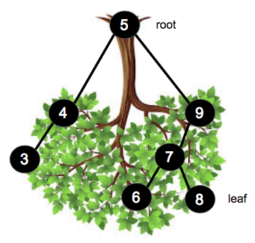
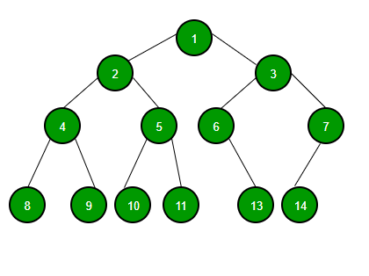
Tree
A Tree is a collection of elements called nodes.
One of the node is distinguished as a root, along with a relation (“parenthood”) that places a hierarchical structure on the nodes.

Slide 31
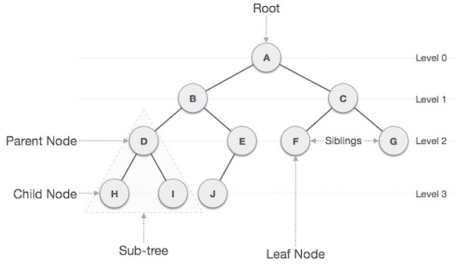

Slide 32
Application of Tree
1. the file system on a computer
2. Store hierarchical data, like folder structure, organization structure, XML/HTML data.
3. Binary Search Tree is a tree that allows fast search, insert, delete on a sorted data. It also allows finding closest item

Slide 33
Graph
A graph is a non-linear data structure which is a collection of vertices (also called nodes) and edges that connect these vertices.
A graph is often viewed as a generalization of the tree structure, where instead of a having a purely parent-to-child relationship between nodes, any kind of complex relationship can exist.
Every node in the graph can be connected with any other node.
When two nodes are connected via an edge, the two nodes are known as neighbors.
D
B
C
A
E

Slide 34
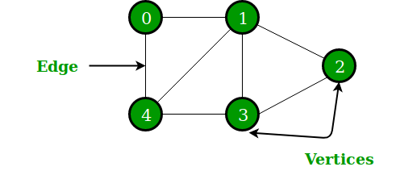
Graph
A graph is a pictorial representation of a set of objects where some pairs of objects are connected by links. The interconnected objects are represented by points termed as vertices, and the links that connect the vertices are called edges.
Formally, a graph is a pair of sets (V, E), where V is the set of vertices and E is the set of edges, connecting the pairs of vertices. Take a look at the following graph

Slide 35
Applications of Graph
In Computer science graphs are used to represent the flow of computation.
Google maps uses graphs for building transportation systems, where intersection of two(or more) roads are considered to be a vertex and the road connecting two vertices is considered to be an edge, thus their navigation system is based on the algorithm to calculate the shortest path between two vertices.
In Facebook, users are considered to be the vertices and if they are friends then there is an edge running between them. Facebook’s Friend suggestion algorithm uses graph theory. Facebook is an example of undirected graph.
In World Wide Web, web pages are considered to be the vertices. There is an edge from a page u to other page v if there is a link of page v on page u. This is an example of Directed graph. It was the basic idea behind Google Page Ranking Algorithm.
In Operating System, we come across the Resource Allocation Graph where each process and resources are considered to be vertices. Edges are drawn from resources to the allocated process, or from requesting process to the requested resource. If this leads to any formation of a cycle then a deadlock will occur.

Slide 36
ADT
ADT means - Abstract Data Type
Definition:
- It’s the logical representation of collection of data in a data structure along with set of operations that are permitted over the data items in the data structure.
- Example
- List ( Creation, Insert, Delete, Search )
-Stack (Push, Pop)
- Queue (Enqueue, Dequeue)

Slide 37
Data Structure Operations
Array ADT
- Creation
- Definition and Declaration
- Insertion
- Deletion
- Sorting
-Searching
- Applications

Slide 38
Data Structure Operations
Stack
- Definition and Declaration (Array / List)
- Insertion (Push)
- Deletion (Pop)
- Searching
- Applications

Slide 39
Data Structure Operations
Linked List
- Definition and Declaration (Structure)
- Creation (Head node)
- Insertion
- Deletion
- Search / Traverse
- Types (Single, Double, Multi, Circular)
- Applications

Slide 40
Data Structure Operations
Queue
- Definition and Declaration (Array / List)
- Insertion ( Enqueue )
- Deletion ( Dequeue)
- Types ( Linear, Circular )
- Applications

Slide 41
Data Structure Operations
Tree
- Definition and Declaration (Array / List)
- Insertion
- Deletion
- Types ( Binary Tree, Binary Search Tree, AVL Tree, RB Tree )
- Applications

Slide 42
Abstract Data Type
An Abstract Data Type (ADT) is the way at which we look at a data structure, focusing on what it does and ignoring how it does its job.
For example, stacks and queues are perfect examples of an abstract data type. We can implement both these ADTs using an array or a linked list. This demonstrates the "abstract" nature of stacks and queues.

Slide 43
Abstract Data Type
In C, an Abstract Data Type can be a structure considered without regard to its implementation. It can be thought of as a "description" of the data in the structure with a list of operations that can be performed on the data within that structure.
The end user is not concerned about the details of how the methods carry out their tasks. They are only aware of the methods that are available to them and are concerned only about calling those methods and getting back the results but not HOW they work.

Slide 44
Algorithm
An “algorithm" is a formally defined procedure for performing some calculation. It provides a blueprint to write a program to solve a particular problem.
It is considered to be an effective procedure for solving a problem in finite number of steps. That is, a well-defined algorithm always provides an answer and is guaranteed to terminate.
Algorithms are mainly used to achieve software re-use. Once we have an idea or a blueprint of a solution, we can implement it in any high level language like C, C++, Java, so on and so forth.

Slide 45
Algorithm
Write an algorithm to find whether a number is even or odd
Step 1: Input the first number as A
Step 2: IF A%2 =0
Then Print "EVEN"
ELSE
PRINT "ODD"
Step 3: END

Slide 46
ALGORITHM
Step by step procedure to solve computational problem
Domain knowledge
Any language/Mathematical notations
Need not worry about H/W or OS
Analyze-space/Time Requirement

Slide 47
CHARACTERSTICS OF ALGORITHM
Input - 0 or more input
Output - At least one O/P
Definiteness - Do not use unknown value
Finiteness - End in one point
Effectiveness - Don’t include unnecessary statements

Slide 48

Searching Algorithms
Linear Search

Slide 49
Need for Searching Algorithms
Data Search − Consider an inventory of 1 million(106) items of a
store. If the application is to search an item, it has to
search an item in 1 million(106) items every time slowing
down the search. As data grows, search will become slower.
This is why searching algorithms are important

Slide 50
Linear search
Linear search or sequential search is a method for finding a
particular value in a list that checks each element in sequence
until the desired element is found or the list is exhausted.
The list need not be ordered.
3. It is very simple and works as follows: We keep on comparing
each element with the element to search until the desired
element is found or list ends.

Slide 51

Example
This is the array we are going to perform linear search
Let’s search for the number 3. We start at the beginning and check the first element in the array.

Slide 52



Is the first value 3? No, not it. Is it the next element?
Is the second value 3?
Not there either. The next element?

Slide 53

Is the third value 3?
Not there either. Next?
Is the fourth value 3? Yes!
We found it!!! Now you understand the idea of linear searching; we go through each element, in order, until we find the correct value.

Slide 54
Linear search - Pseudocode:
# Input: Array D, integer key
# Output: first index of key in D, or -1 if not found
For i = 0 to last index of D:
if D[i] equals key:
return i
return -1

Slide 55
Time Complexity
Best case Analysis
In the linear search problem, the best case occurs when Target is
present at the first location. The number of operations in the
best case is constant (not dependent on n). So time complexity in the best case would be O(1)

Slide 56
Time Complexity
Worst case Analysis
For Linear Search, the worst case happens when the element to be
searched is not present in the array or it is present at the end of
the array.
In this scenario the search() compares it with all the elements of
array one by one. Therefore, the worst case time complexity of linear search would be O(n).

Slide 57
Time Complexity
Average case Analysis
The key is equally likely to be in any position in the array
If the key is in the first array position: 1 comparison
If the key is in the second array position: 2 comparisons ...
If the key is in the ith postion: i comparisons ...
So average all these possibilities:
(1+2+3+...+n)/n = [n(n+1)/2] /n = (n+1)/2 comparisons.
The average number of comparisons is (n+1)/2 = O(n).

Slide 58
Time Complexity
Average case Analysis
In average case analysis, we take all possible inputs and calculate computing time for all of the inputs. Sum all the calculated values and divide the sum by total number of inputs.
We must know distribution of cases. For the linear search problem, let us assume that all cases are uniformly distributed (including the case of
target not being present in array).

Slide 59
Space Complexity
This type of search requires only a single unit of memory to store the element being searched. This is not relevant to the size of the input
Array.
Hence, the Space Complexity of Linear Search is O(1).

Slide 60
QUIZ
1. What is the best case for linear search? a) O(nlogn) b) O(logn) c) O(n) d) O(1) 2. What is the worst case for linear search? a) O(nlogn) b) O(logn) c) O(n) d) O(1)

Slide 61
3. What is the best case and worst case complexity of ordered linear
search? a) O(nlogn), O(logn) b) O(logn), O(nlogn) c) O(n), O(1) d) O(1), O(n)
4. Which of the following is a disadvantage of linear search? a) Requires more space b) Greater time complexities compared to other searching algorithms c) Not easy to understand d) Not easy to implement

Slide 62
5. The array is as follows: 1,2,3,6,8,10. At what time the element 6
is found? (By using linear search algorithm) a) 4th call b) 3rd call c) 6th call d) 5th call

Slide 63

Searching Algorithms
Binary Search

Slide 64
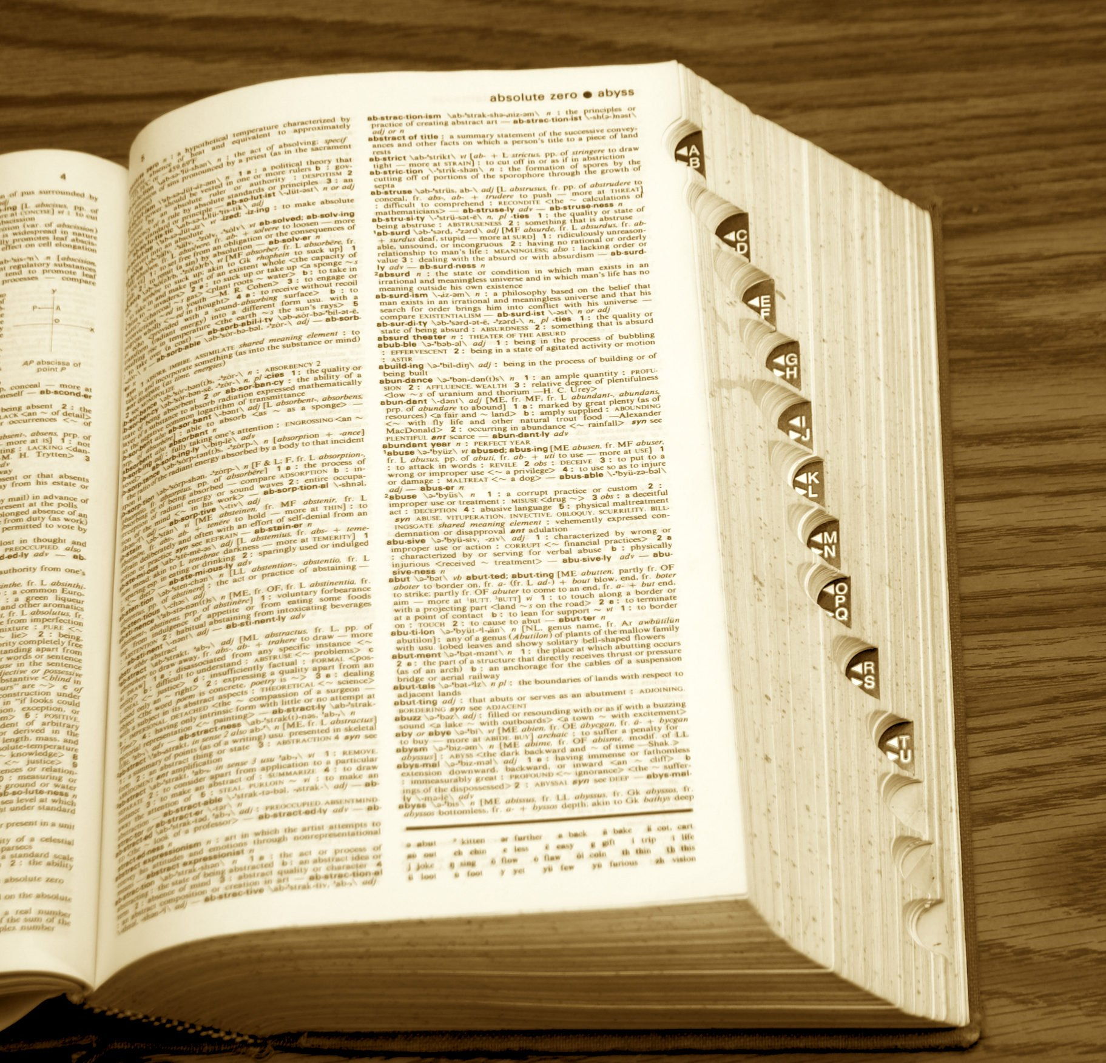

Slide 65
Binary search
The binary search algorithm begins by comparing the target value to the value of the middle element of the sorted array.
If the target value is equal to the middle element's value, then the
position is returned and the search is finished.

Slide 66
Binary search
3. If the target value is less than the middle element's value, then the
search continues on the lower half of the array; or if the target value is
greater than the middle element's value, then the search continues on the upper half of the array.
4. This process continues, eliminating half of the elements, and comparing
the target value to the value of the middle element of the remaining
elements - until the target value is either or until the entire array has
been searched.

Slide 67
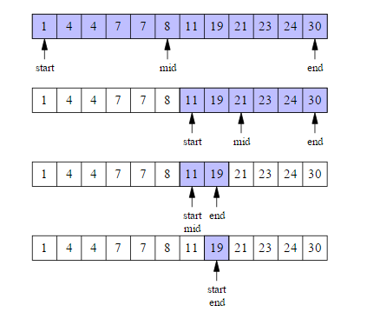
Example
This is the array we are going to perform binary search
Let’s search for the number 19.
In the first step we start with the entire sequence and consider its middle element 8

Slide 68
As the sequence is sorted and 8 is less than the key 19, we conclude that 19 can occur only in the second half of the sequence, not including the middle element 8.

Slide 69
We then repeat the same with the subsequence consisting of the second half. Its middle element is 21, which is greater than the key 19.

Slide 70
We thus next consider the first half of this subsequence, whose middle element is 11. In the last step the subsequence consists of one element, and this element is both the middle element and is equal to the key 19.

Slide 71
Thus we have discovered 19 in the sequence. Observe that only the 4 elements (8, 21, 11 and 19) indexed by the middle point index mid in the figure are compared against the key 19.
If the same search is performed in linear search, it will take 8 comparisons.

Slide 72
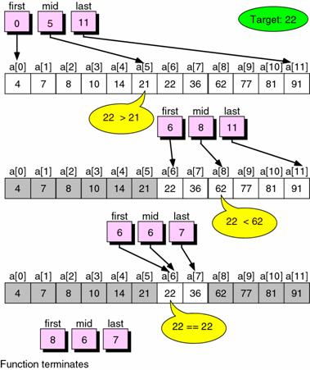
Example 2

Slide 73
Procedure binary_search
A ← sorted array
n ← size of array
x ← value to be searched
Set lowerBound = 1
Set upperBound = n
while x not found
if upperBound < lowerBound
EXIT: x does not exists.
set midPoint = (upperBound + lowerBound ) / 2
if A[midPoint] < x
set lowerBound = midPoint + 1
if A[midPoint] > x
set upperBound = midPoint - 1
if A[midPoint] = x
EXIT: x found at location midpoint
end while
end procedure

Slide 74
Time Complexity
Array
 |  |  |  | n
Sub -Array
n/2
n/2
Therefore the last sub array will be n/n or n/2^{k}
n/4
n/4
K = number of comparisons made
n/8
n/8
.
.
.

Slide 75
n/n = n/2^{k}
n/2^{k} = 1
Time Complexity is O(log n)
n = 2^{k}
Taking log on both the sides
Log n = log 2^{k}
Log n = k log 2
log n = k

Slide 76
Space Complexity
This type of search requires only a single unit of memory to store the element being searched. This is not relevant to the size of the input
Array.
Hence, the Space Complexity of Binary Search is O(1).

Slide 77
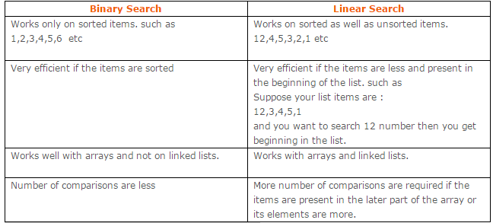

Slide 78
QUIZ
1. What is the best case for binary search? a) O(nlogn) b) O(logn) c) O(n) d) O(1) 2. Binary Search can be categorized into which of the following? a) Brute Force technique b) Divide and conquer c) Greedy algorithm d) Dynamic programming

Slide 79
3. Given an array arr = {5,6,77,88,99} and key = 88; How many iterations are done until the element is found? a) 1 b) 3 c) 4 d) 2

Slide 80
HOW TO ANALYZE AN ALGORITHM
1. Time
2. Space
3. Network (How much data transfer)
4. Power Consumption
5. CPU Registers

Slide 81
HOW TO ANALYZE AN ALGORITHM
swap (a,b)
Begin
temp←a;
a ← b;
b ← temp;
End
Time Complexity
Space Complexity
1 unit
a=1
1 unit
b=1
1 unit
temp=1
F(n)=3
3 words
O(1)
O(1)

Slide 82
Frequency Count Method -Time Complexity
Algorithm sumofn(A,n)
{
S=0;
for(i=0;i<n;i++)
{
S=S+A[i];
}
return s;
}
A=4,6,7,3,9
n=5
i=0 0<5 i++
i=1 1<5 i++
i=2 2<5 i++
i=3 3<5 i++
i=4 4<5 i++
i=5 5<5
Total 6 5
1
n+1
1
n+1
n
n
1
F(n)=2n+3
O(n)

Slide 83
Frequency Count Method –Space Complexity
Algorithm sumofn(A,n)
{
S=0;
for(i=0;i<n;i++)
{
S=S+A[i];
}
return s;
}
S=1
i=1
n=1
A=n
word=n+3
O(n)

Slide 84
Time Complexity O(n²)-Frequency Count Method
for(i=0;i<n,i++)
{
for(j=0,j<n,j++)
{
c[i][j]=a[i][j]+b[i][j]
}
}
n+1
n
*(n+1)
n
*n
n+1+ n² +n+ n² ⁼ 2 n² + 2n + 1
O(n²)

Slide 85
Space Complexity O(n²)-Frequency Count Method
A -> n²
B -> n²
C -> n²
n -> 1
i -> 1
j -> 1
3 n² + 3 = O(n² )
for(i=0;i<n,i++)
{
for(j=0,j<n,j++)
{
c[i][j]=a[i][j]+b[i][j]
}
}
15 | 22
17 | 25

Slide 86
Time and Space Complexity of Algorithm
To analyze an algorithm means determining the amount of resources (such as time and storage) needed to execute it.
Efficiency or complexity of an algorithm is stated in terms of time complexity and space complexity.
Time complexity of an algorithm is basically the running time of the program as a function of the input size.
Similarly, space complexity of an algorithm is the amount of computer memory required during the program execution, as a function of the input size.

Slide 87
Time and Space Complexity of Algorithm
Time complexity of an algorithm depends on the number of instructions executed. This number is primarily dependent on the size of the program's input and the algorithm used.
The space needed by a program depends on:
Fixed part includes space needed for storing instructions, constants, variables, and structured variables.
Variable part includes space needed for recursion stack, and for structured variables that are allocated space dynamically during the run-time of the program.

Slide 88
Calculating Algorithm Efficiency
The efficiency of an algorithm is expressed in terms of the number of elements that has to be processed. So, if n is the number of elements, then the efficiency can be stated as Efficiency = f(n).
If a function is linear (without any loops or recursions), the efficiency of that algorithm or the running time of that algorithm can be given as the number of instructions it contains.
If an algorithm contains certain loops or recursive functions then its efficiency may vary depending on the number of loops and the running time of each loop in the algorithm.

Slide 89
Calculating Algorithm Efficiency
Linear loops
for(i=0;i<100;i++)
statement block
f(n) = (n)
Logarithmic Loops
for(i=1;i<1000;i*=2) for(i=1000;i>=1;i/=2)
statement block; statement block;
f(n) = log n
Nested Loops
Linear logarithmic
for(i=0;i<10;i++)
for(j=1; j<10;j*=2)
statement block;
f(n)= n log n

Slide 90
Big O Notation
Big-O notation, where the "O" stands for "order of", is concerned with what happens for very large values of n.
For example, if a sorting algorithm performs n² operations to sort just n elements, then that algorithm would be described as an O(n²) algorithm.
When expressing complexity using Big O notation, constant multipliers are ignored. So a O(4n) algorithm is equivalent to O(n), which is how it should be written.

Slide 91
Big O Notation
If f(n) and g(n) are functions defined on positive integer number n, then
f(n) = O(g(n))
That is, f of n is big O of g of n if and only if there exists positive constants c and n, such that
f (n) ≤ cg(n)
This means that for large amounts of data, f(n) will grow no more than a constant factor than g(n). Hence, g provides an upper bound.

Slide 92
Categories of Algorithms
Constant time algorithms have running time complexity given as O(1)
Linear time algorithms have running time complexity given as O(n)
Logarithmic time algorithms have running time complexity given as O(log n)
Polynomial time algorithms have running time complexity given as O(nk) where k>1
Exponential time algorithms have running time complexity given as O(2^{n})
n | O(1) | O(log n) | O(n) | O(n log n) | O(n²) | O(n³)
1 | 1 | 1 | 1 | 1 | 1 | 1
2 | 1 | 1 | 2 | 2 | 4 | 8
4 | 1 | 2 | 4 | 8 | 16 | 64
8 | 1 | 3 | 8 | 24 | 64 | 512
16 | 1 | 4 | 16 | 64 | 256 | 4,096

Slide 93
Omega Notation
Omega notation provides a tight lower bound for f(n). This means that the function can never do better than the specified value but it may do worse.
Ω notation is simply written as, f(n) ∈ Ω(g(n)), where n is the problem size and Ω(g(n)) = {h(n): ∃ positive constants c > 0, n₀ such that 0 ≤ cg(n) ≤ h(n), ∀ n ≥ n₀}.
Examples of functions in Ω(n²) include: n², n^{2.9}, n³ + n, 540n² + 10
Examples of functions not in Ω(n³) include: n, n^{2.9}, n²

Slide 94
Theta Notation
Theta notation provides an asymptotically tight bound for f(n).
Θ notation is simply written as, f(n) ∈ Θ(g(n)), where n is the problem size and Θ(g(n)) = {h(n): ∃ positive constants c₁, c₂ and n₀ such that 0 ≤ c₁g(n) ≤ h(n) ≤ c₂g(n), ∀ n ≥ n₀}.
Hence, we can say that Θ(g(n)) comprises a set of all the functions h(n) that are between c1g(n) and c2g(n) for all values of n ≥ n₀.
To summarize,
The best case in Θ notation is not used.
Worst case Θ describes asymptotic bounds for worst case combination of input values.
If we simply write Θ, it means same as worst case Θ.

Slide 95
Little o Notation
Little o notation provides a non-asymptotically tight upper bound for f(n).
To express a function using this notation, we write f(n) ∈ o(g(n)) where o(g(n)) = {h(n) : ∃ positive constants c, n₀ such that for any c > 0, n₀ >0 and 0 ≤ h(n) ≤ cg(n), ∀ n ≥ n₀}.
This is unlike the Big O notation where we say for some c > 0 (not any).
For example, 5n³ = O(n³) is asymptotically tight upper bound but 5n² = O(n³) is non-asymptotically tight bound for f(n).
Examples of functions in o(n³) include: n^{2.9}, n³ / log n, 2n²
Examples of functions not in o(n³) include: 3n³, n³, n³ / 1000

Slide 96
Little Omega Notation
Little Omega notation provides a non-asymptotically tight lower bound for f(n).
It can be simply written as, f(n) ∈ ω(g(n)), where ω(g(n)) = {h(n) : ∃ positive constants c, n₀ such that for any c > 0, n₀ >0 and 0 ≤ cg(n) < h(n), ∀ n ≥ n₀}.
This is unlike the Ω notation where we say for some c > 0 (not any).
For example, 5n³ = Ω (n³) is asymptotically tight upper bound but 5n² = ω(n³) is non-asymptotically tight bound for f(n).
Example of functions in ω(g(n)) include: n³ = ω(n²), n^{3.001} = ω(n³), n²logn = ω(n²)
Example of a function not in ω(g(n)) is 5n² ≠ ω(n²) (just as 5≠5) |

